Slide 1



Principles of
Logistics and Supply Chain Project

Slide 2

OVERVIEW
01
02
03
Intro & Company Profile
Logistic Operations
Challenges & Opportunities
04
05
06
Financial Analysis
Marketing
Conclusion

Slide 3

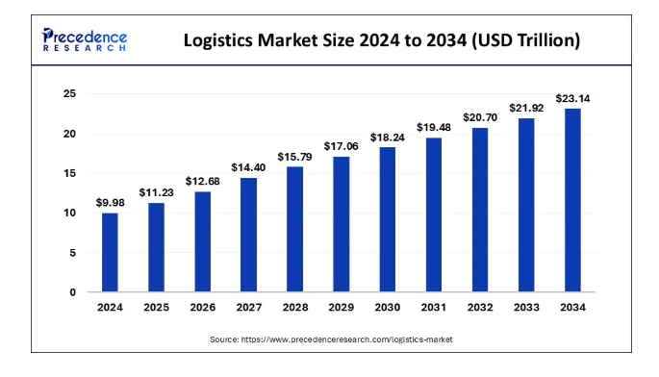

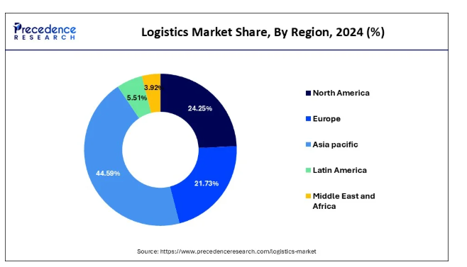


Introduction
Al-Daradkah & Yacoub (2024) define Supply Chain logistics as the management of transportation, manufacturing and distribution of items across the entire supply chain. It comprises both inbound logistics and outbound logistics
01
The global logistics market is experiencing extensive growth. The market value of logistics was $ 11.23 trillion in 2024 and is expected to reach $ 23.14 trillion by the end of 2034
02
The global market share of logistics also varies by region as of 2024, Asia pacific has the largest share of 44.59% and Middle East and Africa has least of 3.92% (Precedence Research, 2025)
03
The Qatari logistic sector is experiencing prompt expansion that is enriched by adequate investment in technological innovation, infrastructural investment and economic diversification growth
04
The freight market of Qatar is projected to be $ 10.14 billion by the end of 2025 and is anticipated to grow with a growth rate of 5.89% by the end of 2030 (Mordor Intelligence, 2023)

Slide 4





Company Overview
History
Business Model
Aramex is a multinational logistics, package delivery and courier company. The head office is situated in the United Arab Emirates and Dubai. The company operates in over than 600 cities of about 70 states. In addition, Aramex also employed about 16, 000 professionals (Aramex, 2024). The company was established in 1982 and becomes the global leader of transportation and logistics sector
The business model revolves around four segments named as International Express, Domestic Express, Freight Forwarding & Logistic Services . Aramex is partnered with domestic and worldwide enterprise and strives for expansion of its business reach. For addressing the concerns of environment and mitigation of climatic change, the business strives for Net-Zero emission by end of 2050 (Aramex, 2024).

Slide 5

Logistic Operations Divisions of Aramex
Freight Forwarding Division offers sophisticated logistic solutions across sea, land and air and ascertains the secure, fast and reliable transport sector.
Air Freight Aramex offers expedited air freight services and ascertains the one-time delivery of items via worldwide borders (Aramex, 2024).
Aramex also contains Land Fright as a contemporary fleet featured with GPS tracking technologies
It also manages one of the biggest and most advanced land freight networks that comprises more than 500 Freight Forwarding decisions
Offers logistic solutions via sea, land and air and ascertain reliable, secure and faster transportation (Al-Daradkah, & Yacoub, 2024).
There is backed by novel technologies, such as the Warehouse Management System (WMS) and Order Management System (OMS)
By the end of 2024, the company will successfully manage its transactions with the worth of 3.4 billion inbound and outbound around a global warehouse footprint of over 800,000 square meters (Aramex, 2024)

Slide 6
Logistic Operations Divisions of Aramex
Operations and Technologies
Aramex emphasizes the improvement of its operational efficiencies and offers innovative solutions (Karam, El Hayek, & Youssef, 2025).
Developed secondary technology hub in India
For improving the customer experience, company delivered better Customer Initiated Returns CIR solution
Sustainability has become the cornerstone of Aramex strategy as business strive to attain net zero emission by end of 2050 (Daradkah, & Yacoub, 2024).
In 2024, Aramex has shown significant progress on upfront level that revealed operational innovation and environmental responsibilities

Slide 7
Logistic Operations Divisions of Aramex
Customer-Centric Logistics Strategy
Aramex's logistic strategy is based on providing a flexible, fast, and transparent delivery experience
offers an extensive service level to fulfil diverse shipment need
Another essential element of strategy is communication and transparency (Qadir et al., 2024).
Online tracking is useful for the effortless monitoring of packages and giving updates in real-time (Wollenberg et al., 2022).
Aramex also emphasized the efficiency and accuracy of the order fulfilment process by applying an advanced system of inventory management and automation (Kempel, & Himpel, 2023)

Slide 8
Logistic Operations Divisions of Aramex
Logistics Services of Aramex
Aramex offers a widespread range of logistics and transportation technologies.
From warehouse to management of facilities and value-added services, the efficiency of business can be improved with an elevated level of customer satisfaction (Rahman et al., 2022).
The company manages and stores its inventory in a strategic location
Aramex also deployed innovative solutions such as ‘On-demand warehousing’ that offers flexible and micro-fulfilment centres
The predominant principles of Aramex are reliability, convenience, and speed.
The Company also provides services for facility management for streamlining operational expenditure and augmenting customer service standards

Slide 9


Challenges & Opportunities of Logistics Management
Aramex faces extensive issues and restricted brand presence in external regions
Aramex brand is also experiencing cultural diversity challenges that cause discrepancies in staff engagement
Aramex is required to maintain a balance with cost management to recalibrate its cost planning (Salem, Alshawtari, & Shatila, 2024).
Strategies for Navigation of Challenges
Aramex is actively pursuing innovation and opportunities for service excellence, expansion of market reach and upholding competitiveness
E-Commerce Expansion
Strategic Collaboration
Sustainable Initiatives

Slide 10

Financial Analysis
January
Aramex reported a stable revenue of $ 426 million, up to 1% year the year in the first quarter of 2025
Domestic Express with 13%, logistics up to 21% and Freight Forwarding with 9%, can offset the reduction in International Express that can be reduced by 13%.
February
The domestic express volume has reduced by 8%
March
The profit of Aramex will be affected by cost inflation by the end of the first quarter of 2025
April
Aramex is emphasizing improved operational efficiencies and an improved model of pricing for unlocking the values of Aramex (Financial Results of Aramex, 2025)
May

Slide 11
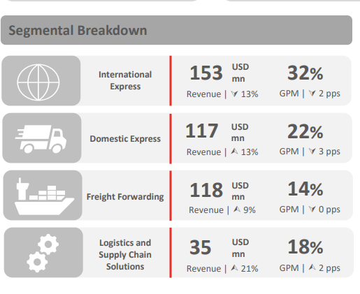
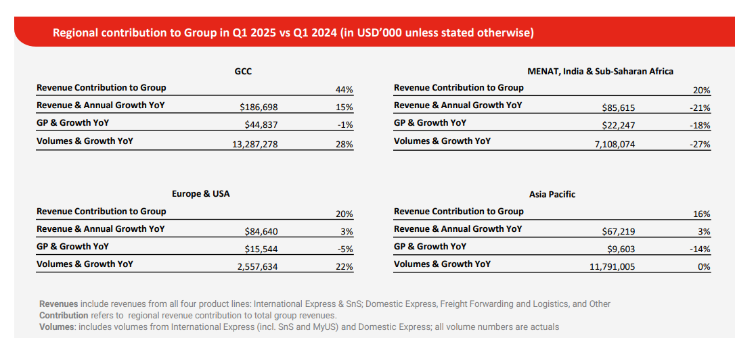
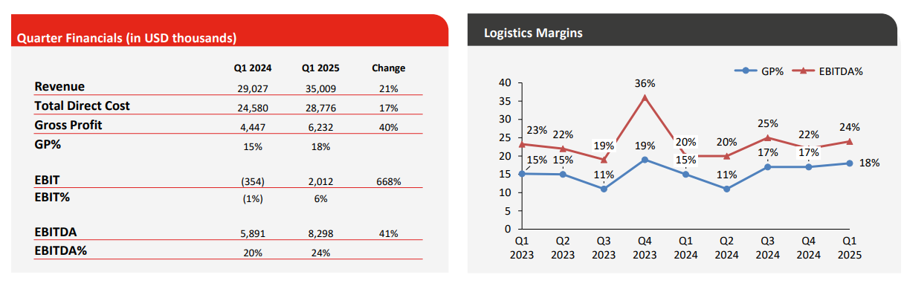


Slide 12


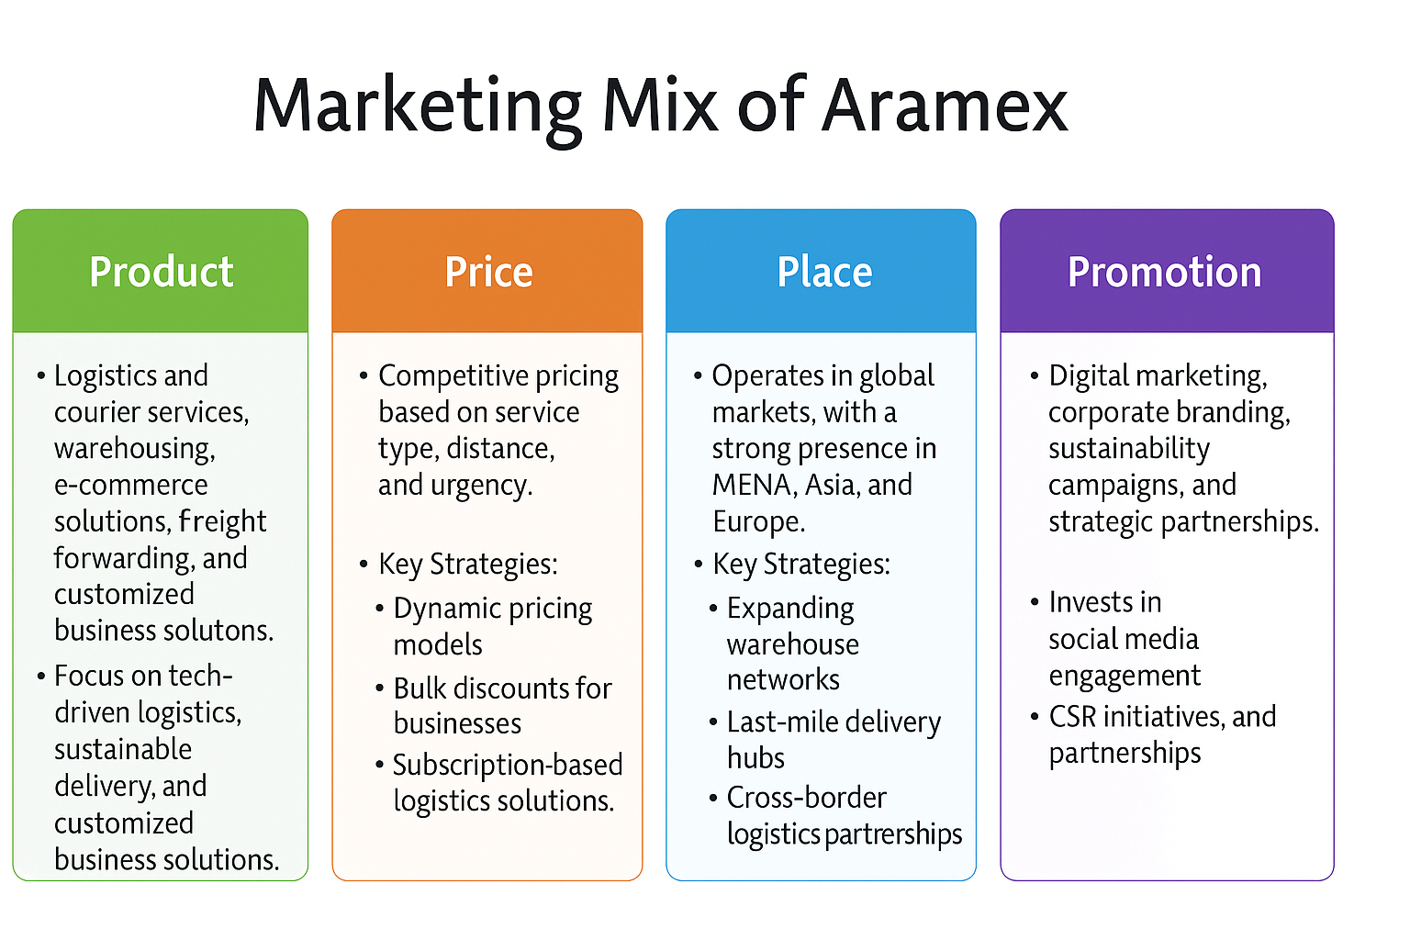

Marketing
Aramex deployed efficient marketing strategies to uphold competitive edge for courier and logistic sector. Company positioned itself as tech-centric logistic sector that emphasized on innovation, customer-oriented and sustainable solution. Company is effectively competing with FedEx and DHL by providing flexible and localized services in emergent marketplace

Slide 13

Conclusion
The company ascertain the effective movement of items and optimal warehouse and offers seamless solutions
for further expansion of business, ongoing innovation is needed to obtain operational resiliency and gain a competitive edge
The Aramex provides last-mile delivery solutions to ascertain order fulfilment through AI-centric optimized routes and an automated dispatching system.
The extensive network of warehouses in multiple countries is optimized for e-commerce fulfilment and multichannel retail and ensures industry-centric storage needs

Slide 14




Recommendations
Aramex has ability to quickly adapt to market shifts can augment a flexible supply chain that can prioritize the experience of customers and contribute a key role in strengthening Aramex's competitive position as a key example of industry leadership
Recommendation 1
Recommndation 2
Recommendation 3
Aramex is advised to strengthen its cold chain logistic expansion for storing and transporting sectors such as the food and pharmaceutical sectors
Aramex can work to augment digitalization by deploying tracking in real-time, Internet of Thing sensors, and predictive analytics to reduce inefficiencies.
Streamlining network of distribution is useful for mitigation of delivery time and operational cost that can elevate the profitability of business.

Slide 15

References
Al-Daradkah, A., & Yacoub, H. (2024). The Impact of Artificial Intelligence on Logistics Support. Library of Progress-Library Science, Information Technology & Computer, 44(3).
Aramex. (2024). Aramex annual integrated report 2024. Retrieved from https://dotcomaramexprod.blob.core.windows.net/default/docs/default-source/annual-reports/aramex-annual-report-2024-en.pdf?sfvrsn=1c46a019_1
Financial Results of Aramex (2025). Q1 2025 investor presentation: Financial results. https://dotcomaramexprod.blob.core.windows.net/default/docs/default-source/investor-presentations/202505006_q1-2025-investor-presentation-final-web_publication.pdf?sfvrsn=ea99a319_1
Karam, J., El Hayek, Z., & Youssef, L. (2025). AI and Cultural Adaptation: Leveraging MENA Values in Business. In AI in the Middle East for Growth and Business: A Transformative Force (pp. 61-73). Cham: Springer Nature Switzerland.
Mordor Intelligence Inc. (2024, January 29). Qatar 3PL Market Size & Share Analysis - Growth Trends & Forecasts (2025 - 2030). https://www.mordorintelligence.com/industry-reports/qatar-3pl-market
Precedence Research. (2025) Logistics Market Size to Hit Around USD 23.14 Tn By 2034. Available at: https://www.precedenceresearch.com/logistics-market
Salem, M. A., Alshawtari, F. A., & Shatila, A. M. (2024). The Impacts of Logistics Performance Indicators on the Competitiveness of GCC Countries. Asian Journal of Middle Eastern and Islamic Studies, 18(4), 393-409.

Slide 16

Thank's For Watching

